Slide 1
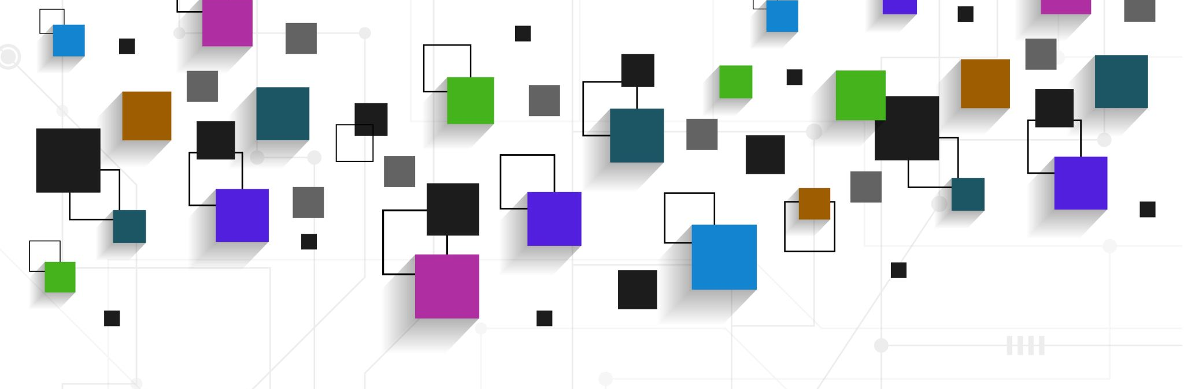
An In-Depth Analysis with Visual Representation of the Criminal Justice Systems throughout the United States
Data Analysis Team
Final Project Report
5/14/2021
Spring 2021
Alex Blank adb19@hood.edu
Juan Pablo Chacon jc34@hood.edu
Natalie Hani nnh2@hood.edu
Lauren Thompson lmt18@hood.edu
Jonathan Wallace jw30@hood.edu

Slide 2
The Project
Problem: The problem that we are faced with is the overabundance and high data volume of incarceration-related data.
Goal: Our goal is to analyze and visualize the large volume of data focusing on specific aspects, issues, and characteristics of the prison system.
Research Issues:
Overcrowding in prisons
Length of stay vs. sentence length
Separation of gender
Charges and their severity
Solution: Develop an interactive visualization dashboard enabling dynamic analysis of data, highlighting the issues that occur within the prison system.

Slide 3
Background & Project Plan
Literature Review
Need and purpose
Summary
Report
Data
Dashboard
Demonstration
Dashboard
Conclusion

Slide 4
Technical Description
D3.js: Visualization
R: Data analysis
Notes:
R : We used it for data analysis because it is an environment that has
an effective data handling and storage facility,
a suite of operators for calculations on arrays, in particular matrices,
a large, coherent, integrated collection of intermediate tools for data analysis,
graphical facilities for data analysis and display either on-screen or on hardcopy, and
a well-developed, simple and effective programming language which includes conditionals, loops, user-defined recursive functions and input and output facilities.

Slide 5
Accomplished Work
Created a literature review based on sources we found and analyzed relating to criminal justice systems in the United States
Created a dashboard to represent data through D3.js.
Github
Notes:
We worked well as a team together to communicate effectively to distribute work evenly and accomplish our goals.
Our goal is researching and developing data analytics to study our research topic. We used specific data handling the number of cases specifically in the United States that are entangled with the issues of overcrowding, separation of gender, extended stays after sentencing, and specific criminal charges. We were well equipped to provide the necessary data analysis infrastructure for anyone to easily fuse and summarize as well as visualize vast amounts of disparate data. We offered a basic statistical analysis and measurements of the data to provide a clear understanding of the subject our research is based upon to demonstrate that our research project was successful in developing a sound data analysis infrastructure. The report will present the purpose of the research, the means and methods used to gather data, the means and methods used to analyze the data, and the conclusions drawn from our analysis.
Github: Github is a code hosting platform for version control and collaboration. It lets users and others work together on projects. By having a collective interactive dashboard through Github the team was able to stay organized and actively provide input on different areas of the project such as datasets, source code, and visual representation of our findings.

Slide 6
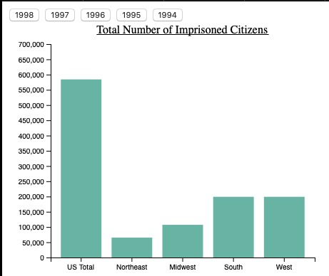
Show Overview

Slide 7
Lessons Learned
Adapted to atypical learning environment, time management
What went wrong: Team communication, unused data
What would we do differently: More efficient use of time on topic selection and data presentation

Slide 8
Future Work
Feature | Purpose
Data Insertion | Easy-to-use method to pass data into the application
Database support | Data storage
Add the US map | Incorporate the US map
Slider | Allows user to observe data as it changes over time
Miscellaneous | -Give user control of slider parameters -Add more information (properties) to each state

